Slide 1

Services
Services
What is Gōjū-ry
Gōjū-ryū (剛柔流), Japanese for "hard & soft style", is one of the main traditional Okinawan styles of karate, featuring a combination of hard and soft techniques.
Gō, which means hard, refers to closed hand techniques or straight linear attacks.
Jū, which means soft, refers to open hand techniques and circular movements.
Gōjū-ryū incorporates both circular and linear movements into its curriculum, combining hard striking attacks such as kicks and close hand punches with softer open hand circular techniques for attacking, blocking, and controlling the opponent, including joint locks, grappling, takedowns, and throws.
Major emphasis is given to breathing correctly in all of the kata but particularly in the Sanchin kata (green belt) which is one of two core kata of this style. The second kata is called Tensho (brown belt), meant to teach the student about the soft style of the system. Gōjū-ryū practices methods that include body strengthening and conditioning, its basic approach to fighting (distance, stickiness, power generation, etc.), and partner drills.
Columbia.edu/cu/goju Contact: goju@columbia.edu

Slide 2
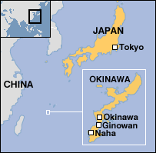
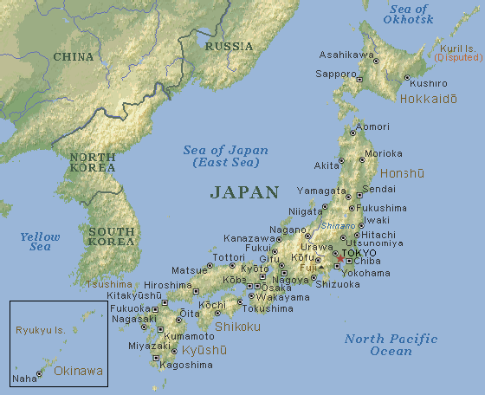
Services
Services
Geographical map of Okinawa
Columbia.edu/cu/goju Contact: goju@columbia.edu

Slide 3





















Services
Services
Promotion requirements Okinawan Goju-Ryu Karate – Hard and Soft style
Our promotions are in the end of each semester, usually the last day of the semester.
Our Ranking system:
10th kyu - white belt no stripes 9th kyu - 1 green stripe 8th kyu - 2 green stripes
7th kyu - green belt 6th kyu - green belt with 1 red stripe
(not often given, usually skipped) 5th kyu - purple belt 4th kyu - purple with 1 brown stripe
(not often given, skipped) 3rd kyu - brown belt 2nd kyu - 1 black stripe 1st kyu - 2 black stripes
Shodan ho (same as 1st kyu) - black belt with 1 white stripe Shodan - 1 red stripe Nidan - 2 red stripes (Sensei rank) Sandan - 3 stripes (Sensei rank) Yondan - 4 stripes (Renshi rank) Godan - 5 stripes Rokudan - 6 stripes (Kyoshi rank) Sechidan - 7 stripes Hachidan - 8 stripes (Shihan rank) Kudan - 9 stripes Judan - 10 stripes (Hanshi rank)
Columbia.edu/cu/goju Contact: goju@columbia.edu

Slide 4
Services
Services
Japanese Counting
Japanese English Pronunciation
ICHI ITCH
NI KNEE
SAN SAN
SHI SHI
GO GO
ROKU ROW
SHICHI SHECHE
HACHI HATCH
KU CUE
JU JEW
Columbia.edu/cu/goju
Contact: goju@columbia.edu

Slide 5
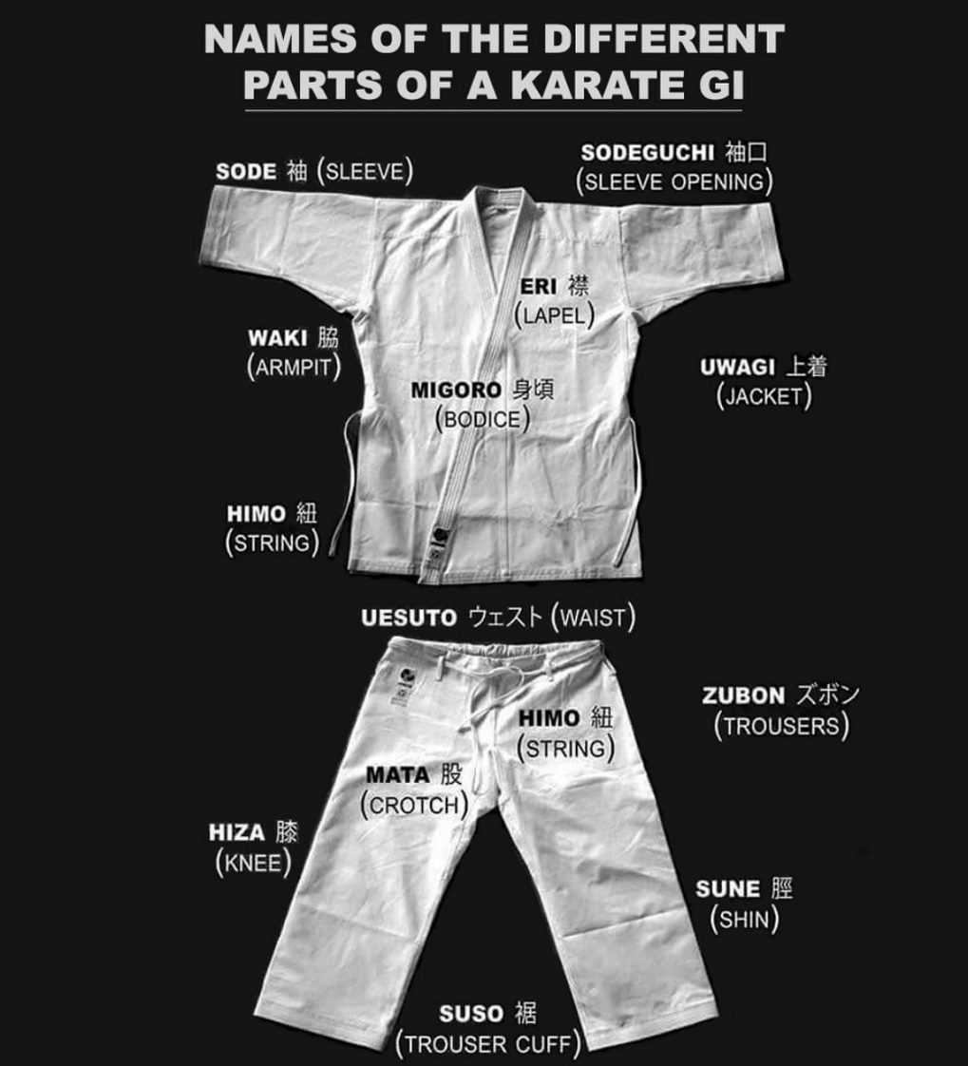
Services
Services

Slide 6
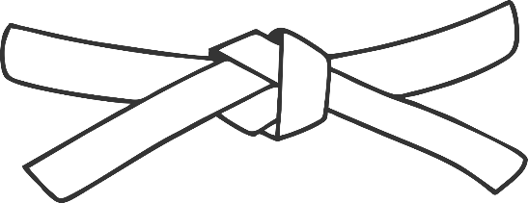
Services
Services
10th Kyu (whit belt with no stripe- beginners level)
Study the martial arts not to defeat other people but to conquer your worst enemy: YOURSELF!
Be open minded - Learn new skills – Caring is the key – Nothing is impossible
Keep an open mind to the lessons in and outside of the dojo
Practice at the dojo and at the home and maintain a sincere dedication to learning
Battle your egos and intellects which will cause you to be in competition with your instructors and dojo brothers/sisters
Leve your negative attitude and problems outside the dojo (training hall)
Students are here to learn, not to teach or debate the issue
Have a clean uniform, be ready for the class, follow instructions
There are many different styles of karate, but we train Goju-Ryu karate
Columbia.edu/cu/goju Contact: goju@columbia.edu

Slide 7
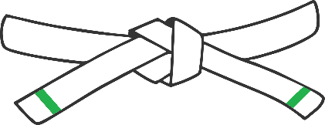
Services
Services
9th kyu - 1 green stripe
Congratulations on your promotion to the 9th Kyu. Now you are officially part of the yuKyu-sha (Kyu ranked members; black belt members are called yudan-sha). Train hard and do not forget the beginner’s mind
Minimum number of classes – our classes are two times per week and each class we learn something new.
For the 9th Kyu – 1 green stripe You have sufficient understanding of the following techniques, knowledge, terminology and have an understanding of etiquette.
Kihon Waza (Basic Techniques)
GERI - kicks
mae geri (front kick)
mawashi geri (roundhouse kick)
Kata
Taikyoku Jodan Uke (elementary upper block kata)
Taikyoku Chudan Uke (elementary middle block kata)
Taikyoku Gedan Uke (elementary low block kata)
UKE - Blocks
jodan age uke (upper rising block)
chudan (soto) yoko uke (middle /out/ side block)
gedan harai uke / gedan barai (lower sweeping block)
DACHI – stances
yoi dachi (opening kata stances)
musubi dachi (ready stance)
sanchin dachi (hourglass stance)
zenkutsu dachi (front stance)
kiba dachi (horse stance)
kokutsu dachi – (back stance)
neko-ashi dachi – (cat stance)
Technik
8 point blocking system (from sanchin dachi)
10 point blocking system (from sanchin dachi)
2 – 3 ipons (self defense techniques)
Punch
oi zuki (lunge punch)
gyaku zuki (reverse punch)
jodan age uke (upper rising block)
chudan yoko uke (middle outside block)
gedan harai uke (lower sweeping block)
Columbia.edu/cu/goju Contact: goju@columbia.edu

Slide 8
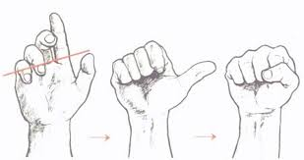
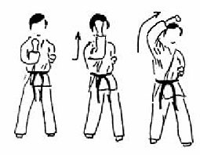
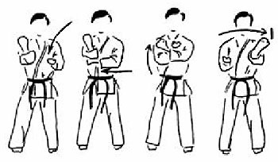
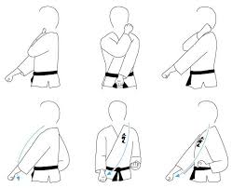
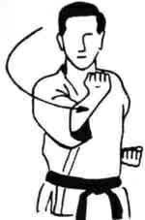
Services
Services
proper fist
jodan (age) uke (upper rising block)
chudan (ude) uke (middle block)
soto uke (middle out side block)
gedan harai uke / gedan barai (lower sweeping block)
Columbia.edu/cu/goju Contact: goju@columbia.edu

Slide 9
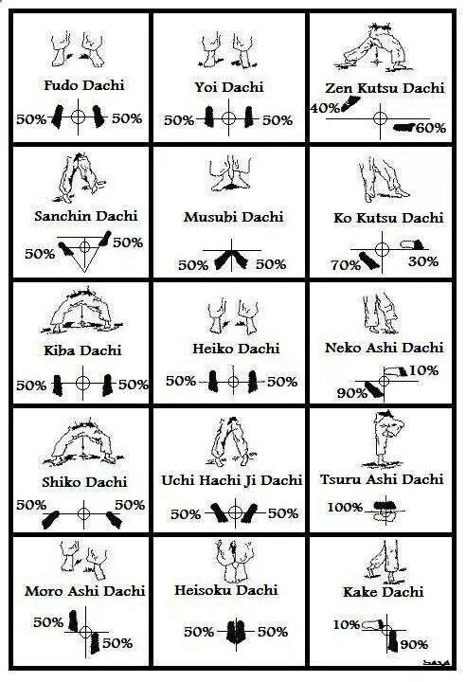
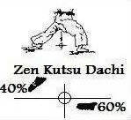
Services
DACHI – stances
yoi dachi (opening kata stances)
musubi dachi (ready stance)
sanchin dachi (hourglass stance)
kiba dachi (horse stance)
kokutsu dachi – (back stance)
neko-ashi dachi – (cat stance)
Columbia.edu/cu/goju Contact: goju@columbia.edu

Slide 10
Services
General knowledge & terminology
Karate - empty hand
Go - hard (from Shotokan)
Ju - soft (from Chinese - White Crain kung fu) – skill that transcends near surfers beauty
History
Karate came from Okinawa, Japan
karate (literally means empty hands, you will find out what is this through your training)
dojo (martial arts school)
gi/dogi (training uniform)
obi (belt)
sensei (teacher/instructor)
senpai (senior students)
hai Sensei (yes, teacher)
arigato gozaimashita (thank you for teaching/helping me)
onegai shimasu (please teach/help me)
sayonara (good bye)
kohai (junior students)
jodan, chudan, gedan (upper level, middle level, lower level)
there are many different styles of karate, but we train Goju-Ryu karate
Columbia.edu/cu/goju Contact: goju@columbia.edu

Slide 11


Services
Services
Columbia University Goju-Ryu Karate
Okinawan Goju-Ryu Karate – Hard and soft style.
Separate from PE class we have Karate Goju-Ryu Club managed by students, but your Sensei is same as the one at a PE class
FOUNDED OVER 37 YEARS AGO!
One of the oldest Martial Arts Clubs on campus!
Produced many black belts and even Senseis over the years.
Remember each class we learn something new and it is the best if you can attend all of them.
MONDAY 7-9PM, Wrestling Room 4 BASICS & FORMS SELF-DEFENSE | WEDNESDAY 7-9PM, Aerobics Room 4 BASICS & FORMS SELF-DEFENSE | FRIDAY 6-8PM Aerobics Room 3 HEAVY BAGS & SPARRING + SELF-DEFENSE
@ColumbiaUniveristyGojuKarate
@cuGojuKarateClub
Columbia.edu/cu/goju Contact: goju@columbia.edu

